Slide 1
OASYS-ShadowOui-Hybrid
Xianbo Shi

Slide 2
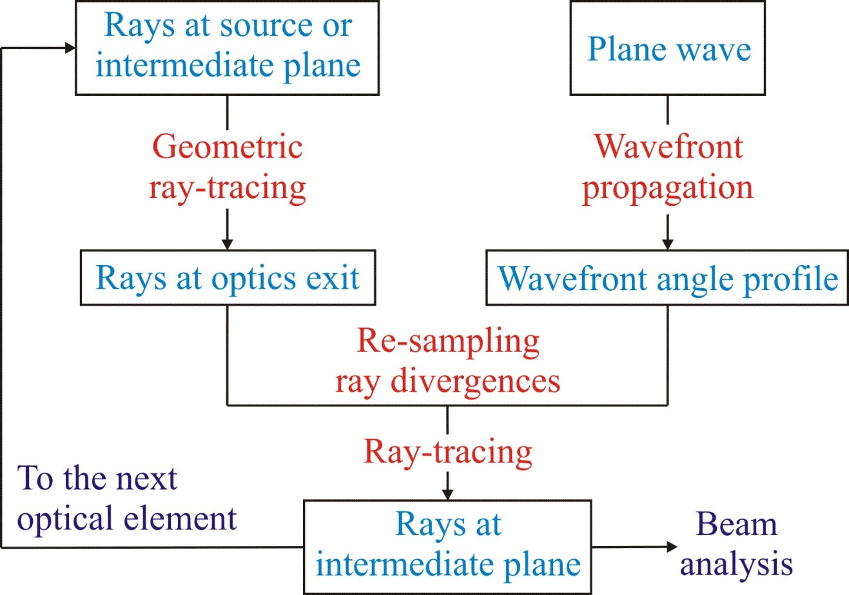
Hybrid method: combining ray-tracing and wavefront propagation
Iterative, valid in far-field approximation
X. Shi, et al., J. Synchrotron Rad. 21, 669 (2014).

Slide 3
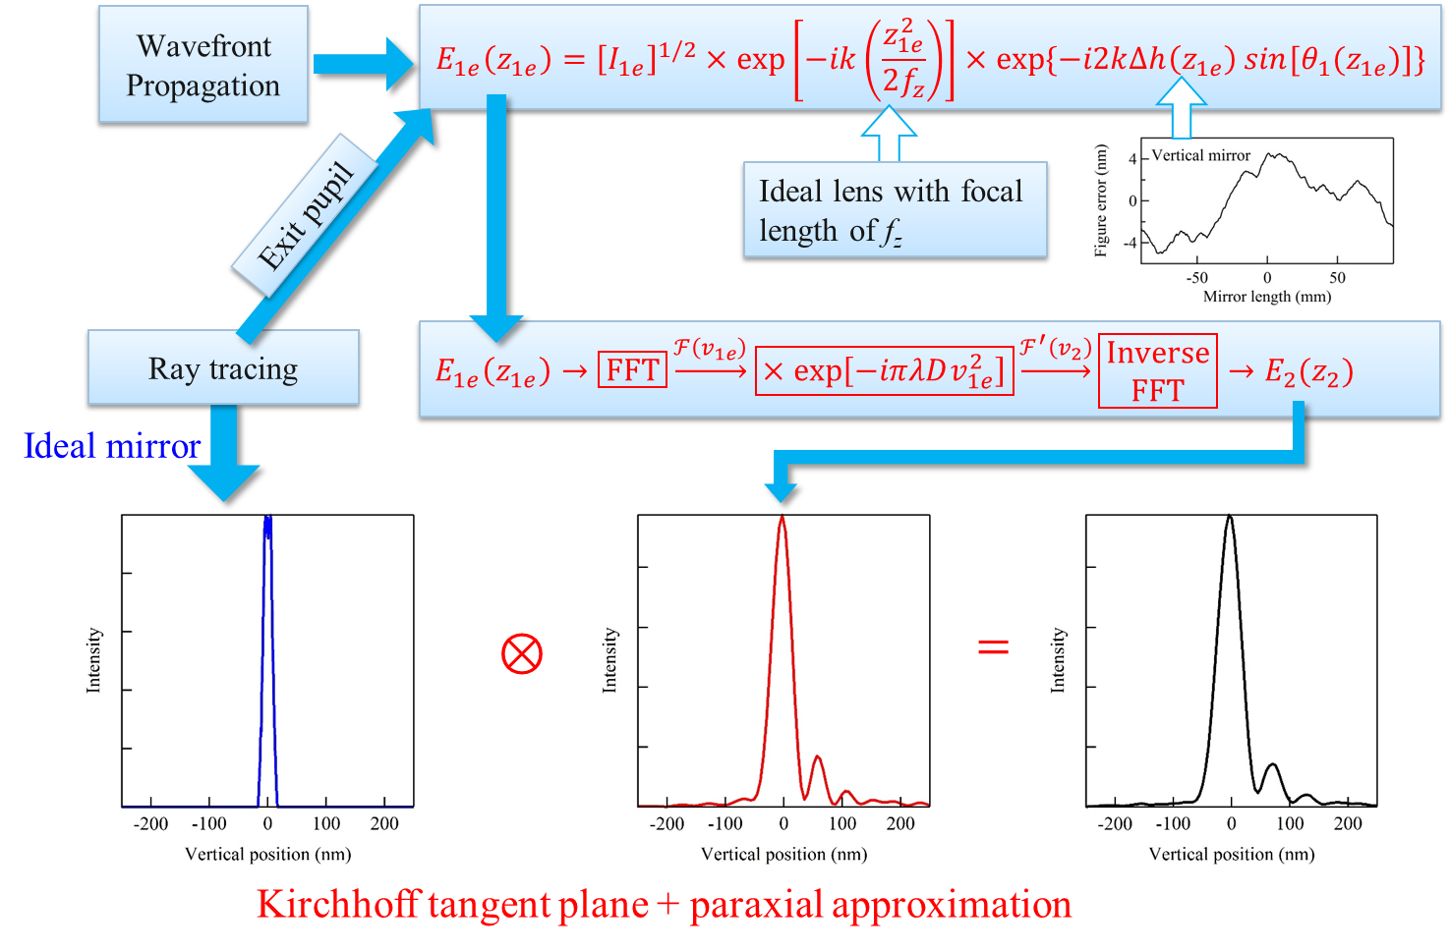
Hybrid method: combining ray-tracing and wavefront propagation

Slide 4
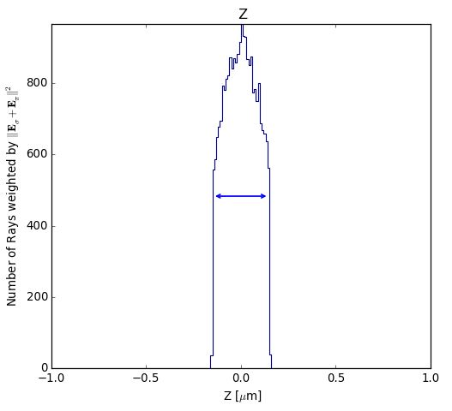
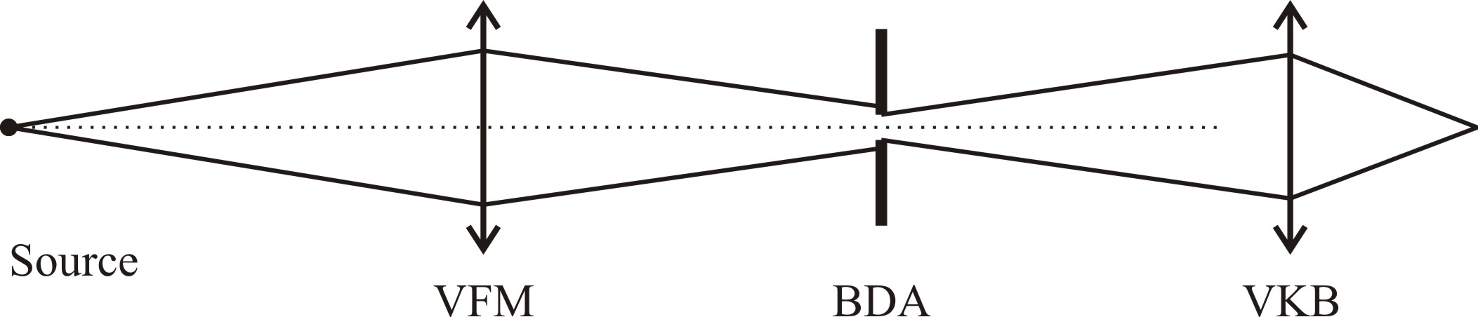
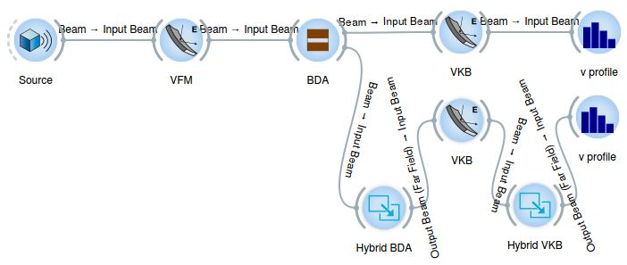

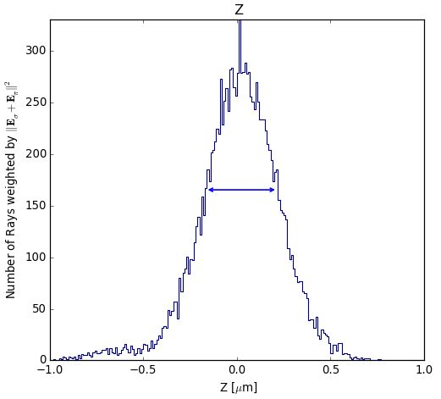
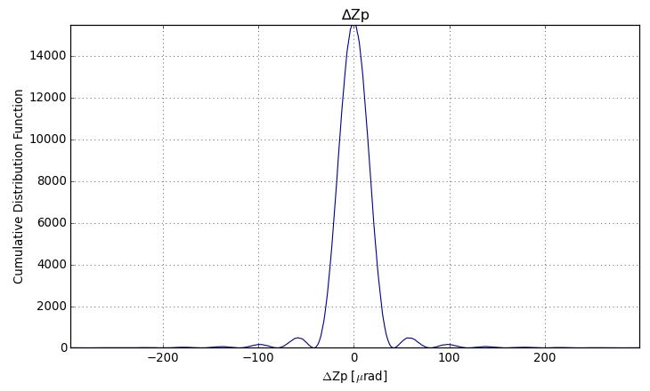
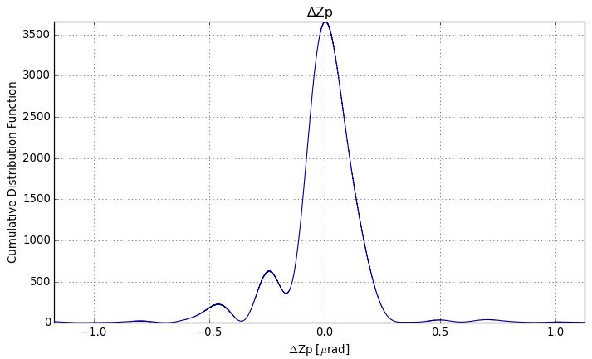
SHADOW-HYBRID in OASYS
X. Shi, et al., J. Synchrotron Rad. 21, 669 (2014).
X. Shi, et al., Proc. SPIE 9209, 920911 (2014).
X. Shi, et al., Proc. SPIE 9209, 920909 (2014).
0.30 µm
0.38 µm

Slide 5
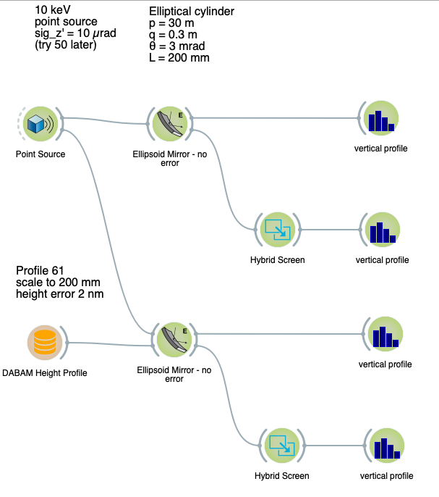
Example 1

Slide 6
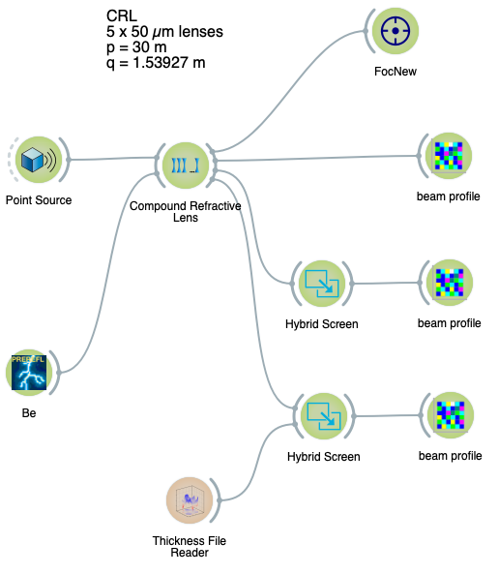
Example 2

